Slide 1

Pathways to University
A College Counseling Workshop for Parents

Slide 2


Agenda
College Counseling at ZIS
  College Timeline
  Guidance and Support
  The BridgeU Platform
Where have ZIS Students Applied? A History of University Acceptance at ZIS
  Discussion: A Range of Opportunity
  Interpreting University Ranking
Advice on Testing
Activity: Imagining Possible Futures

Slide 3

College Timeline Overview for Grade 8-12
 | September | October | November | December | January | February | March | April | May | June/July/August
G12 | Final College List Majors of Interests Rec Letter Requests | Transcript Predicted Grades Resume Personal Statement Rec Letters ready for Submission | Deadline for ED1/EA Applications | College Admissions Decisions for ED1/EA | Deadline for Regular Decision Applications |  | Receive College Admission Decisions For Regular Decision Applications |  | IBDP Exam | Offer Confirmation
G11 | Refine Career Discovery List | Goal-setting Build College List Activities & Leadership Opportunities |  |  |  | Personal Statement Preparation |  |  |  | Summer Program College Visits Volunteer Job
G10 | Academic Interests & Strength Extracurricular Activities ｜ Student Clubs ｜ Academic Competitions ｜Leadership Opportunities | Service |  |  |  |  | Career Discovery University Exploration |  | MYP eAssessment DP HL/SL Course Selection |  | Summer Program College Visits Volunteer Job
G9 | Academic Interests & Strengths |  | Extracurricular Activities | Student Clubs Tournaments & Competitions Services |  |  |  |  |  |  | Summer Program Volunteer Job
G8 | Begin BridgeU Inventories | Explore & Develop Personal Interests | Participate in Extracurricular Activities & Student Clubs
Timeline Overview for College Bound G9-12 Students

Slide 4

Guidance and Support
Connection between IBDP & University Success
One-on-One College Counseling
  University Selection
  Registering & Preparing for Exams
  Recommendation Letters
  Personal Statements
  Interpreting Offers
  Completing Financial Aid Documents

Slide 5

An International Career & University Guidance Platform
Preparation
Discovery
Decision-Making
Student Platform Overview

Slide 6
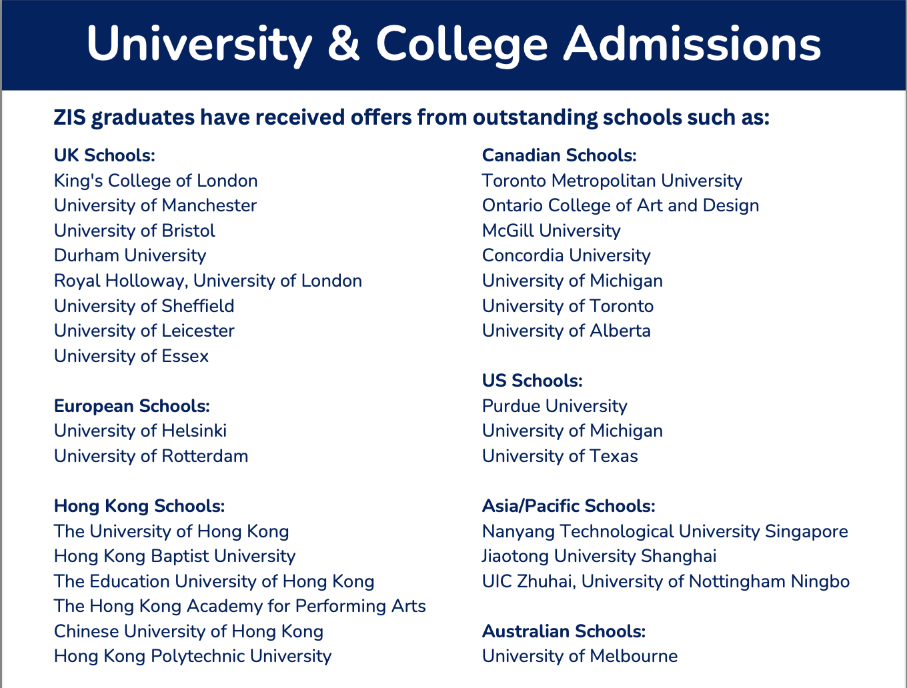
Where have ZIS Students Applied?
A History of University Acceptance at ZIS
*Analysis of the colleges featured on the ZIS School Profile
Discussion:
What trends do you notice from the information collected about these schools?
How would you describe the range of college opportunities open to a ZIS student?

Slide 7



Interpreting University Ranking
Each ranking system follows its methodology and scores universities based on different metrics.
QS focuses a lot on an institution’s reputation among academics and employers, ARWU on world-renowned research, and THE tries to balance the two, taking more variables into account.
Whether a university is 5th or 7th, 120th or 150th doesn’t mean there is a big difference between them. Many factors are at play, some unrelated to teaching quality. So, If you try to decide between two universities with close ranking positions, let’s say 25th and 40th, simply ignore this fact. It doesn’t reflect which one is better. It’s more useful to think of them in terms of Top 10, Top 50, Top 100, and Top 500.
(Ciubotaru, 2024)
Notes:
The performance indicators are grouped into five areas: Teaching (the learning environment); Research environment (volume, income and reputation); Research quality (citation impact, research strength, research excellence and research influence); International outlook (staff, students and research); and Industry (income and patents). (THE Reporters, 2024a)
The data is collected via a tool called the "Academic Reputation Survey," an "annual questionnaire targets only experienced, published scholars, who offer their views on excellence in research and teaching within their disciplines and at institutions with which they are familiar" (THE Reporters, 2024b).
The QS World University Rankings uses its own sent of indicators, some of which are the same as THE but others not. The Academic Ranking of World Universities (ARWU) uses 6 criteria to measure schools including: number of awards received, amount of citations of their teaching staff, number of papers published by faculty in the Nature and Science magazine, number of papers that are indexed in the Social Science Citation Index, and the Science Citation Index-Expanded, per capita performance of staff, and alumni success (Somani, 2024).
The "take away" is that, while school rank can give you some information, there are significant limits to the information it can provide. It is only one data point among a number of data points in the university selection process. If referenced with insight, it can help students narrow their choices based on their values, approaches to learning, and long-term goals, but ranking should not weigh more heavily in the decision-making process than other factors.

Slide 8
Advice on Testing
International English Language Testing System (IELTS)
  Created by the British Council, IDP: IELTS Australia, and Cambridge Assessment English
  Score between 1-9 in each of 4 sections (reading, listening, speaking, writing) (*Universities usually want 6.5 - 7.5)
  $198 registration fee
  Wide range of study materials available
Scholastic Assessment Test (SAT)
  Applicable to colleges in US & beyond; plays an important role in grants and scholarships!
  Score between 400 – 1600 (US Avg Score: 1,028)
  Measures academic performance with a strong focus on mathematics, grammar, and analytical writing skills
  $68 registration fee
  Wide range of Pre-SAT & study materials
Test of English as a Foreign Language (TOEFL)
  Created by the Educational Testing Service (Princeton, NJ, USA)
  Score based on four sections (reading, listening, speaking, writing); each section has 30 points, for a maximum score of 120 points total. (*80 – 100 is considered proficient; top universities want 100+ )
  $49 registration fee
  (Mendis, 2025)
American College Testing (ACT)
  Applicable to US colleges
  1 to 36 (US Avg. Score: 19.5)
  Measures grammar, reading comprehension, scientific reasoning, and math skills
  $63 / $88 (with writing) registration fee
  Pre-ACT and some study materials
Other language proficiency exams
  Cambridge English
  EF Set Test
  Duolingo
*IB English course scores

Slide 9

Activity: Imagining Possible Futures
Consider your child's:
  Personality traits
  Approaches to learning
  Possible career interests
  Academic interests
  Personal interests
  Work & productivity
  University locations & programs
Complete the profile card for your child and take a photo before submitting it.

Slide 10
Upcoming Workshop Topics
Exploring the BridgeU Parent Portal
College Fairs & University Tours (Virtual & In-Person)
  How to get the most out of your college fair experience
Exam Prep Resources
Paying for College

Slide 11
References
Ciubotaru, A. (2024, June 19). How to interpret university rankings and what are they good for? - mastersportal.com. Study Portals Masters. https://www.mastersportal.com/articles/3081/how-to-interpret-university-rankings-and-what-are-they-good-for.html
HIGH5TEST. (2024, September 26). Academic Strengths & Weaknesses: Q&A and 25 examples. HIGH5 Strengths Test. https://high5test.com/academic-strengths-and-weaknesses/
Mendis, D. (2025, January 24). Guide for International Students: International Standardized Tests. Shorelight. https://shorelight.com/student-stories/international-standardized-tests/
Ok, E. (2025, April 16). 78 best examples of employee strengths and weaknesses. Teamflect. https://teamflect.com/blog/performance-management/employee-strengths
The Myers-Briggs Company. (2023, July 20). The 16 MBTI Personality Types. Myers-Briggs Foundation. https://www.myersbriggs.org/my-mbti-personality-type/the-16-mbti-personality-types/
World-leading education software and services. BridgeU. (2025, January 30). https://bridge-u.com/

